Slide 1
Go Lions!!!

Slide 3
Welcome to Rotary!
Meditation
Kurt Heise
Broadcaster
Al Blixt

Slide 4
Lunch signup
Sign up is important
If you can’t sign up electronically, call or email Marie
734-453-6879 x4
Marie.morrow@pcuw.org
Salad Options
Maurice Salad
Caesar with or w/o chicken
Greek with or w/o chicken
Spinach with or w/o chicken
Mediterranean

Slide 5
It’s Lunch Time Chicken Fettuccine Alfredo
Please invite our guests to go first
Meeting will resume in about 20 minutes
This Photo by Unknown Author is licensed under CC BY-NC-ND

Slide 6
January Birthdays
Nancy Baldwin 3rd
Don Soenen 4th
Win Schrader 10th
Jeff Horton 17th
Denise King 21st
Julie Howell-Romein 28th

Slide 7
February 23rd – The Sun Never Sets on Rotary Meeting March 9th – Rotary Exhibit at the Museum July 4th - Parade
Upcoming Dates

Slide 8
Wayne County Executive
Warren Evans

Slide 9
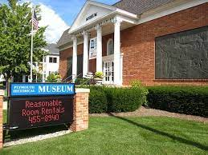
Plymouth Historical Museum Executive Director
Liz Kerstens

Slide 11
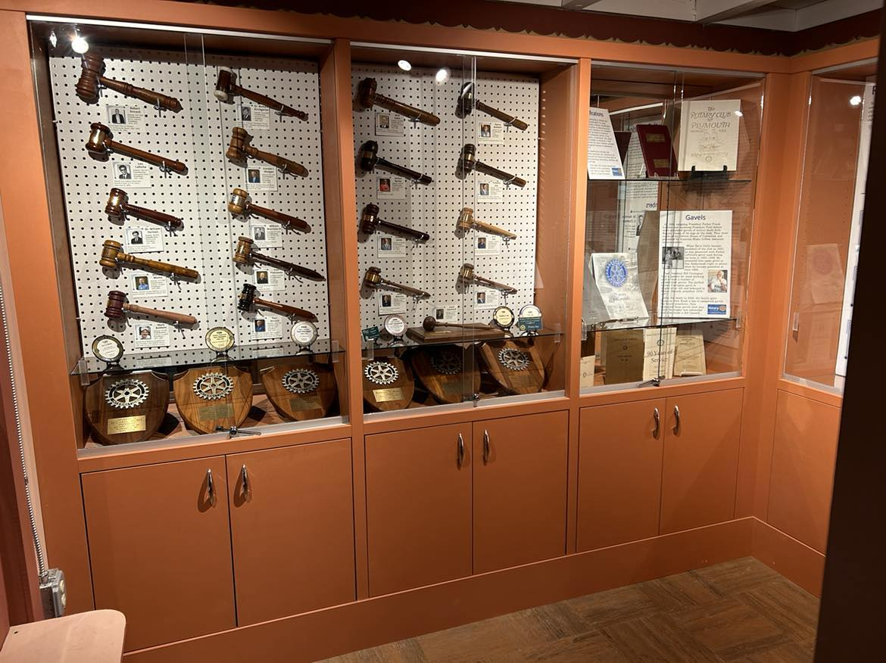

Slide 12
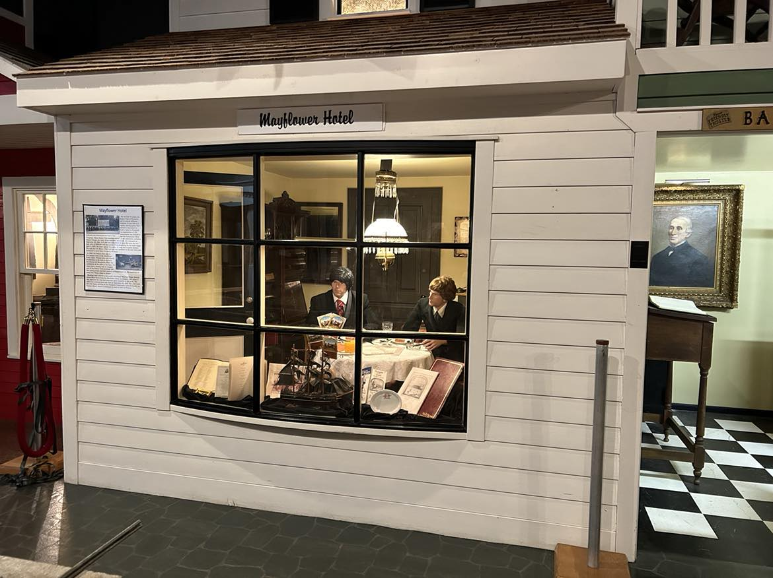

Slide 13
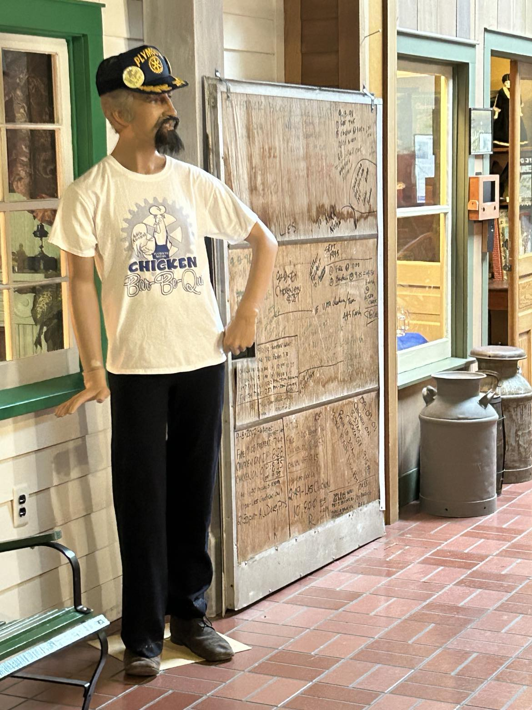

Slide 14
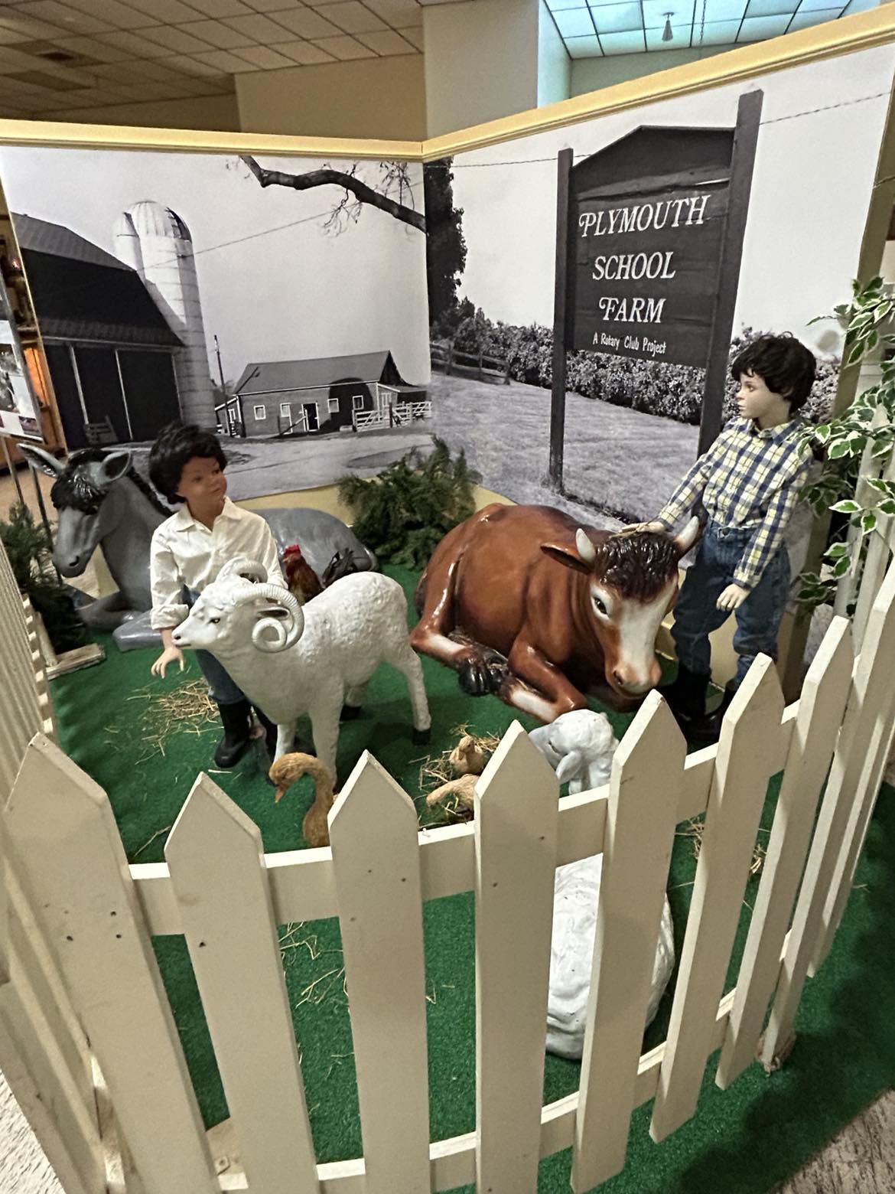

Slide 15
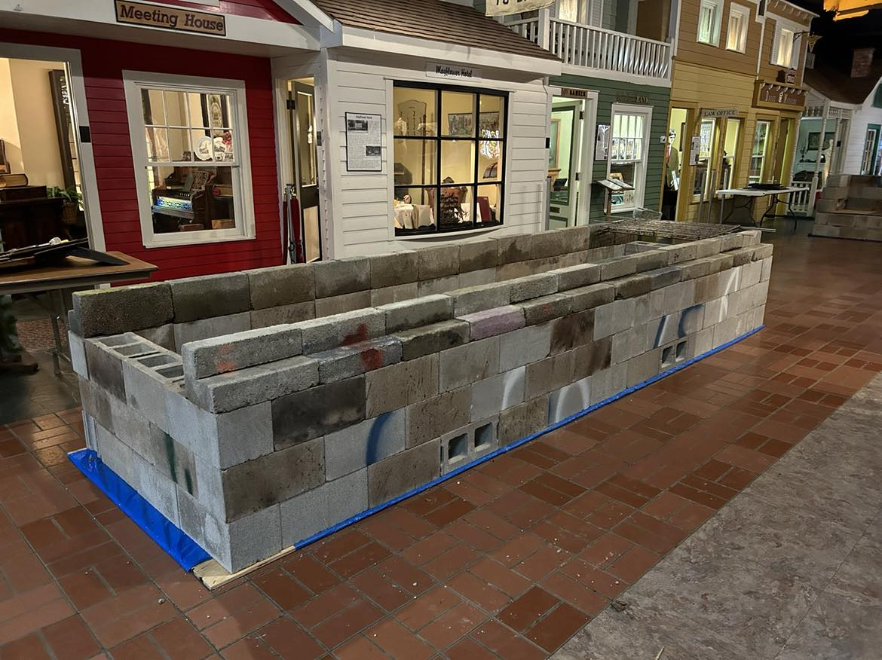

Slide 16
50/50 DRAWING And the winner is …..?
This Photo by Unknown Author is licensed under CC BY

